Slide 1

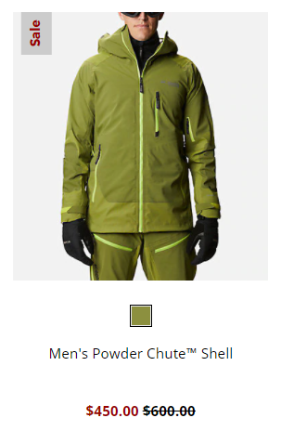

Business Case
Build a statistical model that predicts if a product will sell above or below 2,000 units
Below 2k or Above 2k?

Slide 2
Model Comparison
Statistical Model | Accuracy | Sensitivity | Specificity | Pos Pred | Neg Pred
Generalized Logistic Model | 60% | 8% | 77% | 10% | 72%
Decision Tree | 84% | 63% | 86% | 34% | 95%
Support Vector Machine | 83% | 81% | 84% | 21% | 99%
Random Forest | 86% | 68% | 88% | 46% | 95%
XGBoost | 85% | 68% | 87% | 39% | 96%

Slide 3
Applied Logistic Regression Final Project
Final Oral Exam
MS Data Analytics
12/1/20
Prepared By: Josh Olsen

Slide 4
Agenda
Intro
Data Analytics Framework
Statistical Modeling
Other Classification Models
Future Work

Slide 5
Intro
About Me
Objective of Final Project
Business Case
Questions of Interest

Slide 6






About Me
Supply Chain Demand Planner
Supply Chain Demand Planner
2013
2015
2020
Masters of Science Data Analytics
Bachelor of Science Supply & Logistics Management

Slide 7
Objective of Final Project
Take learnings from the program to a real-world supply chain business problem in an enterprise setting
Supply Chain
Data Analytics

Slide 8
Business Case
Products that do not sell over 2,000 units is problematic to Columbia Sportswear’s Supply Chain due high production minimums.
Two Outcomes:
Excess inventory or
No production of product
This problem is often invisible due to bias in the forecasting process.

Slide 9
Business Case
Build a statistical model that predicts if a product will sell above or below 2,000 units
Below 2k or Above 2k?

Slide 10
Questions of Interest
Are there any interesting relationships between the explanatory variables?
How accurate is a Generalized Logistic Model (G.L.M.)?
Which variables are important in the G.L.M.?
With the same explanatory variables, how does the G.L.M. compare to other classification statistical models?

Slide 11
Data Analytics Framework
Game Plan for project
10 Step Process

Slide 12
Data Prep
Feature Engineering
Model Assumptions
Review of the Data
Data Clean Up
Adding Variables
Independence
Skewness
Observations
Data Structure
Multi-collinearity
Model Diagnostics Part 1
Training Set
Training Set
Goodness of Fit
Over/Zero Dispersion
Updated Statistical Model
Statistical Model
Non-Important Variables
Model Diagnostics Part 2
Interactions of Variables
Training Set
Goodness of Fit
ROC Curve
Testing Set
Updated Statistical Model
Model Results
Over/Zero Dispersion
AIC Model Comparison
Interactions
Non-Important Variables

Slide 13
Data Prep
Feature Engineering
Model Assumptions
Review of the Data
Data Clean Up
Adding Variables
Independence
Skewness
Observations
Data Structure
Multi-collinearity
Model Diagnostics Part 1
Training Set
Training Set
Goodness of Fit
Over/Zero Dispersion
Updated Statistical Model
Statistical Model
Non-Important Variables
Model Diagnostics Part 2
Interactions of Variables
Training Set
Goodness of Fit
ROC Curve
Testing Set
Updated Statistical Model
Model Results
Over/Zero Dispersion
AIC Model Comparison
Interactions
Non-Important Variables

Slide 14
Review of the Data
Product related dataset with unit sales from 7/1/17 to 6/30/20
Mostly Categorical Explanatory Variables
First half of the year is considered “Spring” while the second half of the year is considered “Fall”
Less than 2k unit threshold for binary response
Greater than 2k = 1
Less than 2k = 0

Slide 15
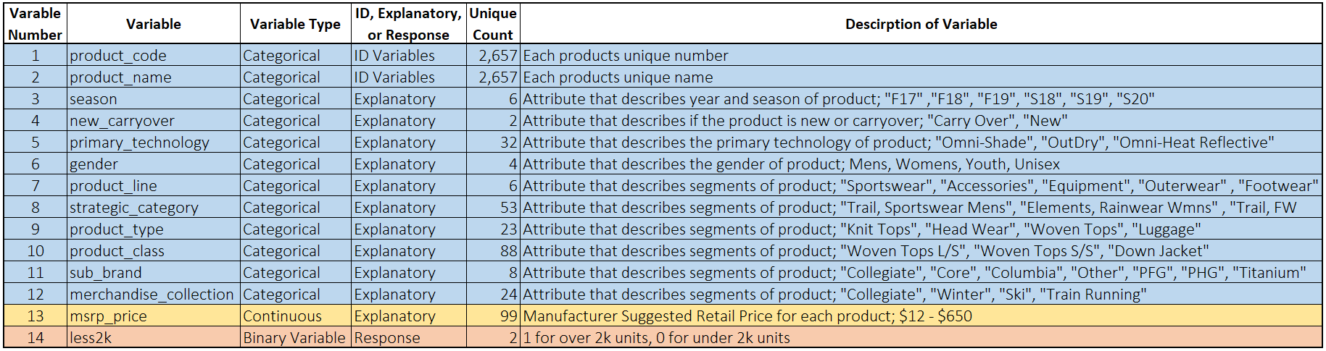
Review of the Data
7,568 Observations

Slide 16
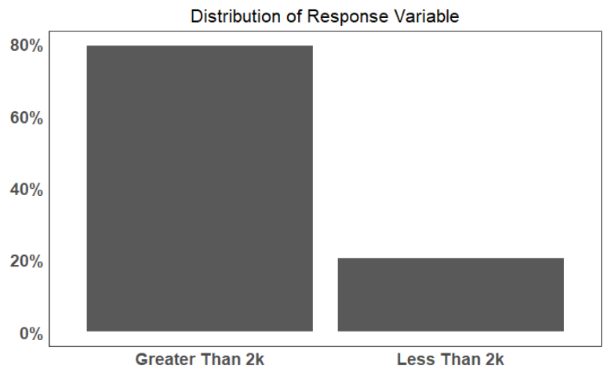
Observations

Slide 17
Data Clean Up
Missing Data
Sparse Data

Slide 18
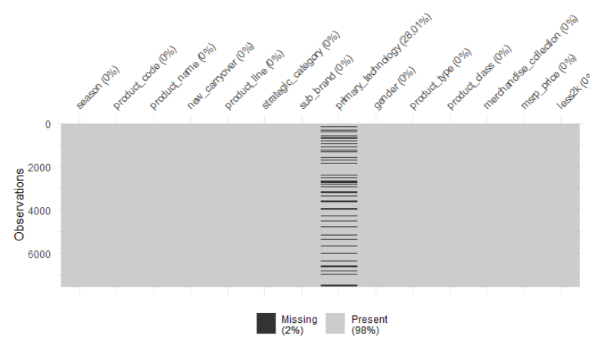
Missing Data
Primary_technology missing = No Technology

Slide 19
Data Clean Up
Sparse Data
Obsolete Products Removed
Low amount of factors inside explanatory variable

Slide 20
Obsolete Products Removed
Segments of product that are no longer active and have extremely low amount of instances
Removed 10 instances in Adera and Outdoor from in sub_brand variable

Slide 21
Low Amount of Factors
Less than 15 factors inside each explanatory variable recoded with Misc. Category
Applied to:
primary_technology
product_type
product_class

Slide 22
Data Prep
Feature Engineering
Model Assumptions
Review of the Data
Data Clean Up
Adding Variables
Independence
Skewness
Observations
Data Structure
Multi-collinearity
Model Diagnostics Part 1
Training Set
Training Set
Goodness of Fit
Over/Zero Dispersion
Updated Statistical Model
Statistical Model
Non-Important Variables
Model Diagnostics Part 2
Interactions of Variables
Training Set
Goodness of Fit
ROC Curve
Testing Set
Updated Statistical Model
Model Results
Over/Zero Dispersion
AIC Model Comparison
Interactions
Non-Important Variables

Slide 23
Updated Variable List
Added Spring or Fall Indicter Explanatory Variable
If Season contains S = Spring
If Season contains F = Fall

Slide 24
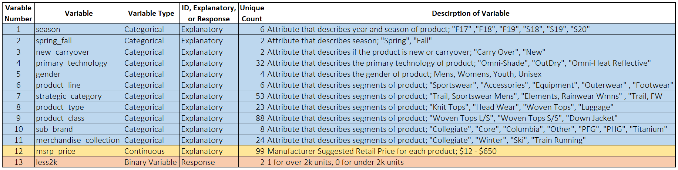
Updated Variable List

Slide 25
Data Prep
Feature Engineering
Model Assumptions
Review of the Data
Data Clean Up
Adding Variables
Independence
Skewness
Observations
Data Structure
Multi-collinearity
Model Diagnostics Part 1
Training Set
Training Set
Goodness of Fit
Over/Zero Dispersion
Updated Statistical Model
Statistical Model
Non-Important Variables
Model Diagnostics Part 2
Interactions of Variables
Training Set
Goodness of Fit
ROC Curve
Testing Set
Updated Statistical Model
Model Results
Over/Zero Dispersion
AIC Model Comparison
Interactions
Non-Important Variables

Slide 26
Model Assumptions
Independence
Skewness
Correlation

Slide 27
Independence
Observations to be independent of each other
DON’T REMOVE repeated measures
Should not come from repeated measurements or matched data.

Slide 28
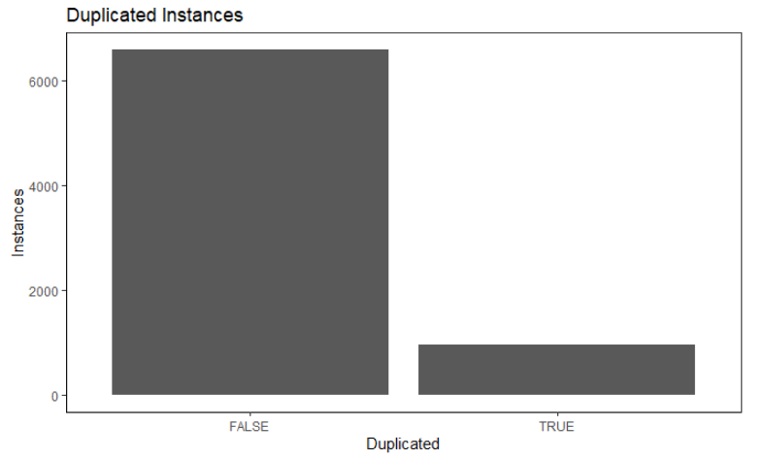
Independence
~13% are duplicated
Reduced Observations
from 7,568 to 6,598

Slide 29
Skewness
Not Applicable for Logistic Regression
Logistic Regression does not need to be normally distributed.

Slide 30
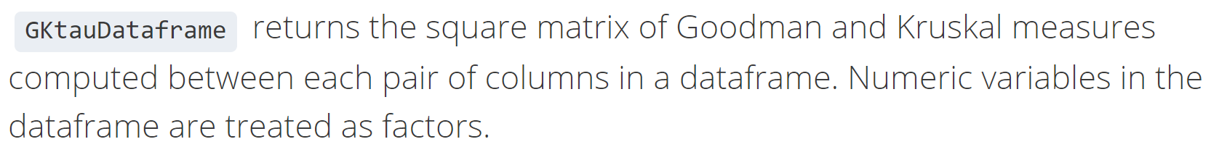
Multi-collinearity
The Goodman and Kruskal Tau measure
Asymmetric association measure between two categorical variables
Note that this matrix is generally NOT symmetric,
in contrast to standard correlation matrices.
https://www.rdocumentation.org/packages/GoodmanKruskal/versions/0.0.3/topics/GKtauDataframe
Notes:
https://www.rdocumentation.org/packages/GoodmanKruskal/versions/0.0.3/topics/GKtauDataframe

Slide 31
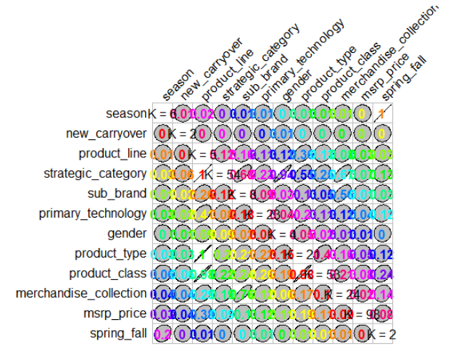
The Goodman and Kruskal Tau Measure
Greater than 0.75 =
Strong Correlation
Notes:
https://www.rdocumentation.org/packages/GoodmanKruskal/versions/0.0.3/topics/GKtauDataframe

Slide 32
Strategic Category Variable
Correlated with
Product Line
Gender
Drop Strategic
Category
Strategic Category | Product Line | Gender
Trail, Outerwear Mens | Outerwear | Mens
Trail, Outerwear Wmns | Outerwear | Womens
Trail, Sportswear Mens | Sportswear | Mens
Trail, Sportswear Wmns | Sportswear | Womens
Water, FW Mens | Footwear | Mens
Water, FW Wmns | Footwear | Womens
Notes:
Strategic Category - Product Line & Gender

Slide 33
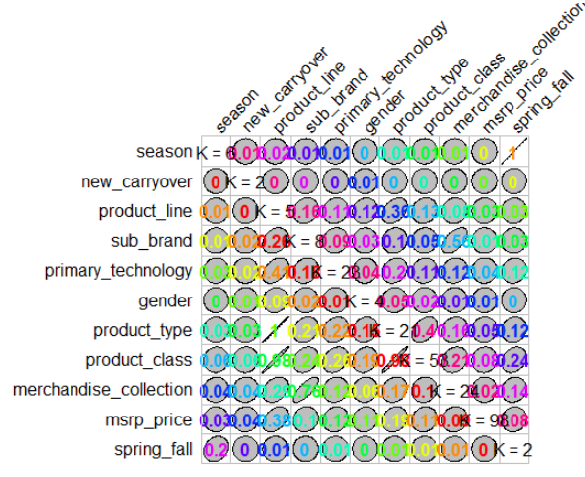
Product Type Variable
Correlated with
Product Line
Drop Product Line
Product Type | Product Line
Boots | Footwear
Dress | Sportswear
Jackets | Outerwear
Luggage | Equipment
Packs | Equipment
Sandals | Footwear
Notes:
Strategic Category - Product Line & Gender
Product Type – Product Line

Slide 34
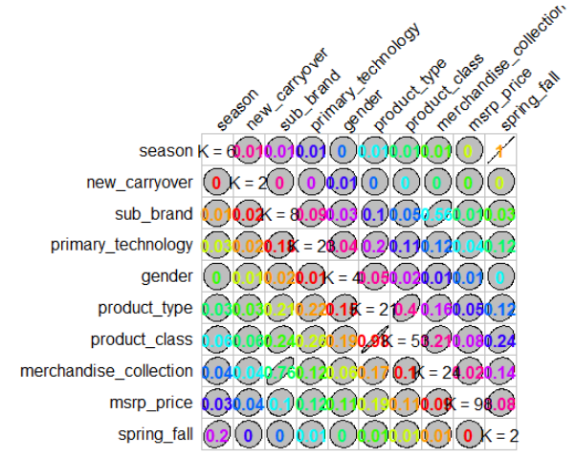
Product Class Variable
Correlated with
Product Type
Drop Product Type
Product Class | Product Type
Baselayer Heavyweight Bottoms | Baselayer
Baselayer Heavyweight Tops | Baselayer
Insulated Synthetic Tops | Jackets
Headwear | Head Wear
Down Jkt | Jackets
Flip | Sandals
Notes:
Strategic Category - Product Line & Gender
Product Type – Product Line
Product Class – Product Type

Slide 35
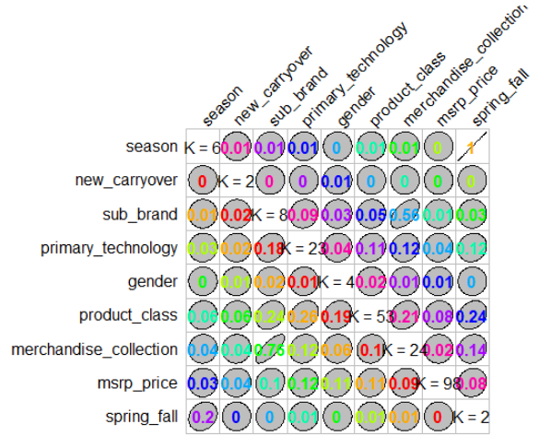
Merchandise Collection Variable
Correlated with
Sub Brand
Drop Merchandise
Collection
Merch. Coll. | Sub Brand
Snow Sports | Columbia
Snow Sports | Titanium
PFG | Columbia
PFG | PFG
Ski | Columbia
Ski | Titanium
Notes:
Strategic Category - Product Line & Gender
Product Type – Product Line
Product Class – Product Type
Merchandise Collection – Sub Brand

Slide 36
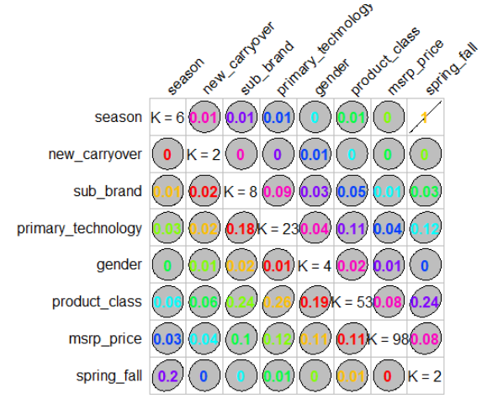
Season Variable
Correlated with
Spring Fall
Drop Season
Season | Spring Fall
F17 | Fall
F18 | Fall
F19 | Fall
S18 | Spring
S19 | Spring
S20 | Spring
Notes:
Strategic Category - Product Line & Gender
Product Type – Product Line
Product Class – Product Type
Merchandise Collection – Sub Brand
Season – Spring Fall

Slide 37
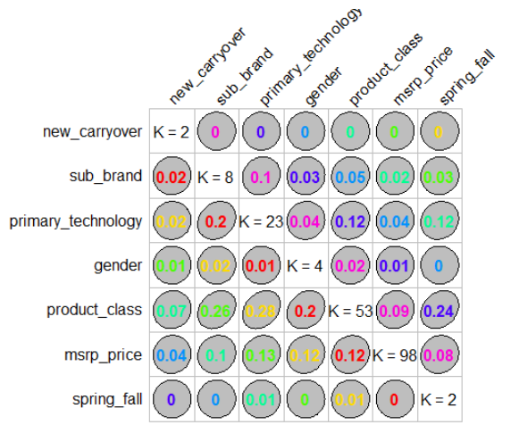
Updated Plot
No more issues with
Multi-collinearity

Slide 38
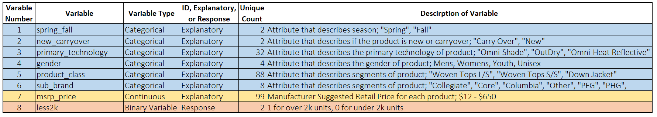
Updated Variable List

Slide 39
Training and Test Dataset Cut
Training Set 75%
Testing Set 25%
Context around validation set
Why 75% and why 25%?

Slide 40
Data Prep
Feature Engineering
Model Assumptions
Review of the Data
Data Clean Up
Adding Variables
Independence
Skewness
Observations
Data Structure
Multi-collinearity
Model Diagnostics Part 1
Training Set
Training Set
Goodness of Fit
Over/Zero Dispersion
Updated Statistical Model
Statistical Model
Non-Important Variables
Model Diagnostics Part 2
Interactions of Variables
Training Set
Goodness of Fit
ROC Curve
Testing Set
Updated Statistical Model
Model Results
Over/Zero Dispersion
AIC Model Comparison
Interactions
Non-Important Variables

Slide 41
Generalized Logistic Model Intro
Model the probability of the binary response depending on values of explanatory variables
Estimate the probability that an event occurs versus the probability event does not occur
Predict the effect of explanatory variables on the binary response variable
Classify observations by estimating the probability that an observation is in a particular category

Slide 42
GLM #1
GLM
glm(less2k ~
new_carryover + primary_technology + gender + product_class + sub_brand + msrp_price + spring_fall,
data=training_set, family=binomial(link="logit"))

Slide 43
Data Prep
Feature Engineering
Model Assumptions
Review of the Data
Data Clean Up
Adding Variables
Independence
Skewness
Observations
Data Structure
Multi-collinearity
Model Diagnostics Part 1
Training Set
Training Set
Goodness of Fit
Over/Zero Dispersion
Updated Statistical Model
Statistical Model
Non-Important Variables
Model Diagnostics Part 2
Interactions of Variables
Training Set
Goodness of Fit
ROC Curve
Testing Set
Updated Statistical Model
Model Results
Over/Zero Dispersion
AIC Model Comparison
Interactions
Non-Important Variables

Slide 44
Model Diagnostics Part 1
Goodness of Fit
Over/Zero Dispersion
Non-Important Variables

Slide 45
Deviance Goodness of Fit
Evaluate the adequacy of a model
Null hypothesis- assumes that there is no significant difference between the observed and the expected value.
Alternative hypothesis- assumes that there is a significant difference between the observed and the expected value.
Reject the Null Hypothesis
Goodness of Fit Test
Null Deviance | 4957.266
Residual Deviance | 4110.726
Degrees of Freedom | 82
P Value from Chi-Square | 0
Notes:
Hypothesis test – p value of hypothesis – all the betas are not zero – explaining response better than nothing

Slide 46
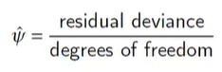
Over/Zero Dispersion
To see if there is more variability that can be described by the binomial distribution
The Dispersion Parameter is less than one, suggests there is no Over/Zero dispersion
4110.7 / 4631 = 0.8876

Slide 47
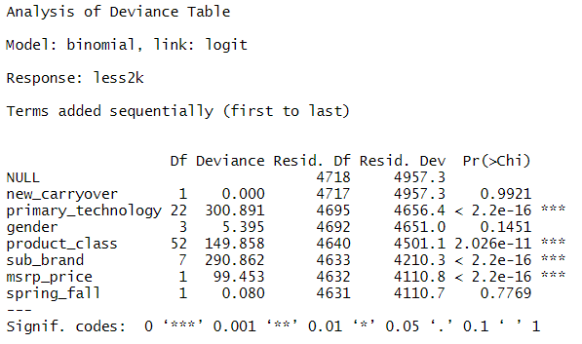
Non-Important Variables
Likelihood ratio test
Drop new_carryover
Notes:
P-values testing one parameter

Slide 48
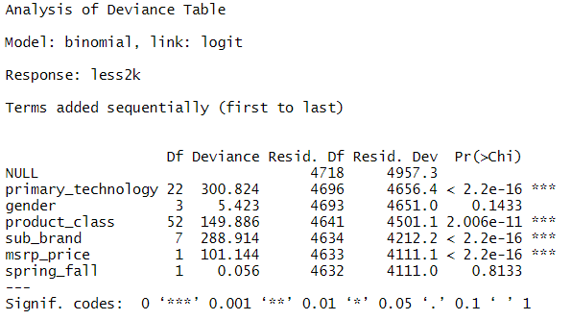
Non-Important Variables
Drop spring_fall
Notes:
P-values testing one parameter

Slide 49
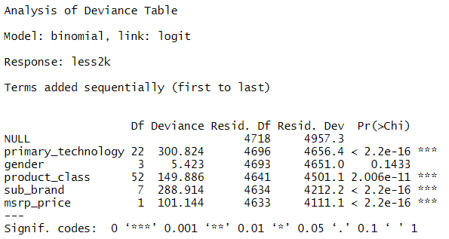
Non-Important Variables
Drop gender
Notes:
P-values testing one parameter

Slide 50
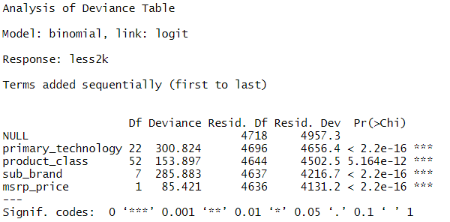
Non-Important Variables
All explanatory variables are important
Notes:
P-values testing one parameter

Slide 51
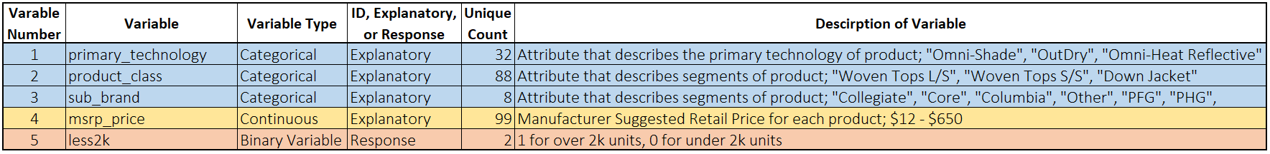
Updated Variable List

Slide 52
Data Prep
Feature Engineering
Model Assumptions
Review of the Data
Data Clean Up
Adding Variables
Independence
Skewness
Observations
Data Structure
Multi-collinearity
Model Diagnostics Part 1
Training Set
Training Set
Goodness of Fit
Over/Zero Dispersion
Updated Statistical Model
Statistical Model
Non-Important Variables
Model Diagnostics Part 2
Interactions of Variables
Training Set
Goodness of Fit
ROC Curve
Testing Set
Updated Statistical Model
Model Results
Over/Zero Dispersion
AIC Model Comparison
Interactions
Non-Important Variables

Slide 53
GLM #2
GLM
glm(less2k ~
primary_technology + product_class + sub_brand + msrp_price,
data=training_set, family=binomial(link = "logit"))

Slide 54
Data Prep
Feature Engineering
Model Assumptions
Review of the Data
Data Clean Up
Adding Variables
Independence
Skewness
Observations
Data Structure
Multi-collinearity
Model Diagnostics Part 1
Training Set
Training Set
Goodness of Fit
Over/Zero Dispersion
Updated Statistical Model
Statistical Model
Non-Important Variables
Model Diagnostics Part 2
Interactions of Variables
Training Set
Goodness of Fit
ROC Curve
Testing Set
Updated Statistical Model
Model Results
Over/Zero Dispersion
AIC Model Comparison
Interactions
Non-Important Variables

Slide 55
Interactions of Explanatory Variables
Consider Interactions between the explanatory variables
Does the interaction between sub_brand and msrp_price to response variable?

Slide 56
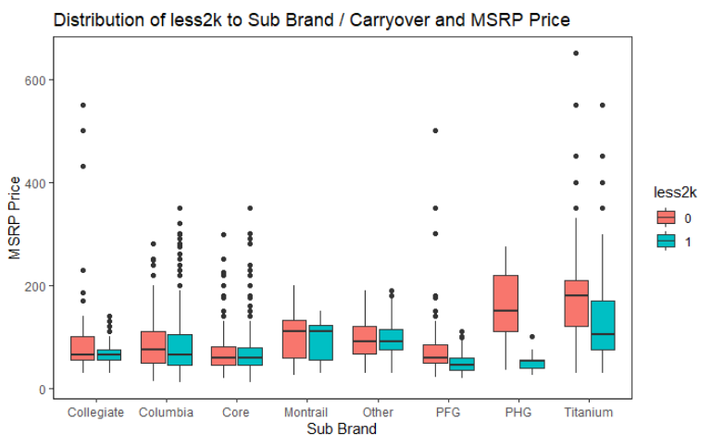
Sub Brand and MSRP Price Interaction

Slide 57
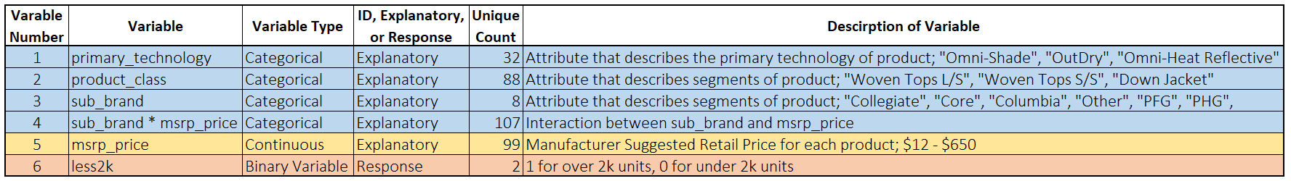
Updated Variable List

Slide 58
Data Prep
Feature Engineering
Model Assumptions
Review of the Data
Data Clean Up
Adding Variables
Independence
Skewness
Observations
Data Structure
Multi-collinearity
Model Diagnostics Part 1
Training Set
Training Set
Goodness of Fit
Over/Zero Dispersion
Updated Statistical Model
Statistical Model
Non-Important Variables
Model Diagnostics Part 2
Interactions of Variables
Training Set
Goodness of Fit
ROC Curve
Testing Set
Updated Statistical Model
Model Results
Over/Zero Dispersion
AIC Model Comparison
Interactions
Non-Important Variables

Slide 59
GLM #3
GLM
glm(less2k ~
less2k ~ primary_technology + product_class + sub_brand + msrp_price + sub_brand * msrp_price
data=training_set, family=binomial(link="logit"))

Slide 60
Data Prep
Feature Engineering
Model Assumptions
Review of the Data
Data Clean Up
Adding Variables
Independence
Skewness
Observations
Data Structure
Multi-collinearity
Model Diagnostics Part 1
Training Set
Training Set
Goodness of Fit
Over/Zero Dispersion
Updated Statistical Model
Statistical Model
Non-Important Variables
Model Diagnostics Part 2
Interactions of Variables
Training Set
Goodness of Fit
ROC Curve
Testing Set
Updated Statistical Model
Model Results
Over/Zero Dispersion
AIC Model Comparison
Interactions
Non-Important Variables

Slide 61
Model Diagnostics Part 2
Goodness of Fit
Over/Zero Dispersion
Non-Important Variables
AIC Model Comparison
ROC Curve at final model

Slide 62
Deviance Goodness of Fit
Evaluate the adequacy of a model
Null hypothesis- In Chi-Square goodness of fit test, the null hypothesis assumes that there is no significant difference between the observed and the expected value.
Alternative hypothesis- In Chi-Square goodness of fit test, the alternative hypothesis assumes that there is a significant difference between the observed and the expected value.
Reject the Null Hypothesis
Goodness of Fit Test
Null Deviance | 4957.266
Residual Deviance | 4040.738
Degrees of Freedom | 89
P Value from Chi-Square | 0
Notes:
Hypothesis test – p value of hypothesis – all the betas are not zero – explaining response better than nothing

Slide 63
Over/Zero Dispersion
To see if there is more variability that can be described by the binomial distribution
The Dispersion Parameter is less than one, suggests there is no Over/Zero dispersion
4040.7 / 4629 = 0.8729

Slide 64
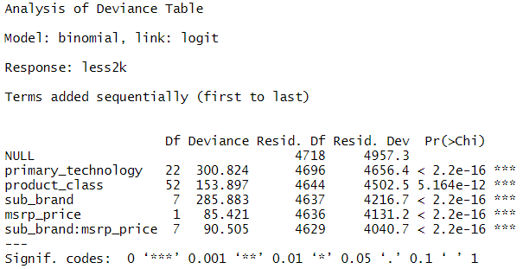
Non-Important Variables
Interaction between sub_brand and msrp_price is important

Slide 65
AIC Comparisons
AIC estimates the quality of each model
How the Updated GLM Model compares to the Updated GLM Model with Interactions?
AIC Decreased 76.505
Model | AIC
GLM #2 | 4297.243
GLM #3 with Interactions | 4220.738

Slide 66
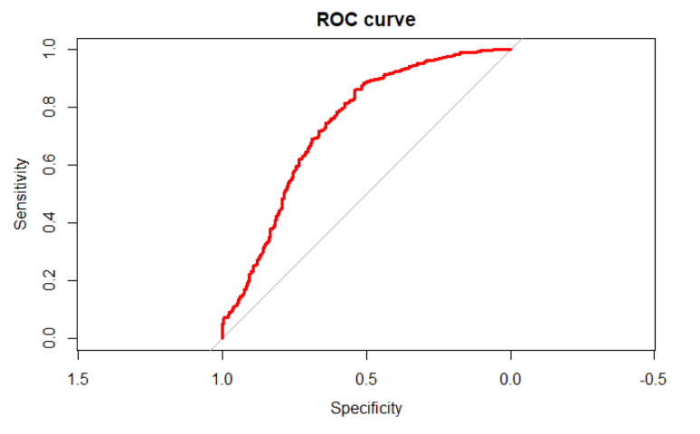
ROC Curve
“closest.topleft”
The optimal threshold is the point closest to the top-left part of the plot with perfect sensitivity or specificity.
“closest.topleft”
The optimal threshold is the point closest to the top-left part of the plot with perfect sensitivity or specificity.
To determine cut off threshold
Threshold set to 0.90

Slide 67
Data Prep
Feature Engineering
Model Assumptions
Review of the Data
Data Clean Up
Adding Variables
Independence
Skewness
Observations
Data Structure
Multi-collinearity
Model Diagnostics Part 1
Training Set
Training Set
Goodness of Fit
Over/Zero Dispersion
Updated Statistical Model
Statistical Model
Non-Important Variables
Model Diagnostics Part 2
Interactions of Variables
Training Set
Goodness of Fit
ROC Curve
Testing Set
Updated Statistical Model
Model Results
Over/Zero Dispersion
AIC Model Comparison
Interactions
Non-Important Variables

Slide 68
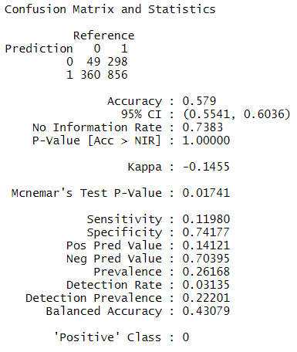
Confusion Matrix
Confusion Matrix
 | 0 | 1
0 | True Positive | False Negative
1 | False Positive | True Negative
Key Definitions
Accuracy of Model
Sensitivity | Correct Negative Predictions divided by the total number of Negatives
Specificity | Correct Positive Predictions divided by the total number of Positive
Pos Pred | Correct True Positive divided by the total number of True Positive and False Negative
Neg Pred | Correct True Negative divided by the total number of False Postive and True Negative

Slide 69
GLM #3 Results
Confusion Matrix
 | 0 | 1
0 | True Positive | False Negative
1 | False Positive | True Negative
Confusion Matrix
Accuracy of Model
Sensitivity | Correct Negative Predictions divided by the total number of Negatives
Specificity | Correct Positive Predictions divided by the total number of Positive

Slide 70
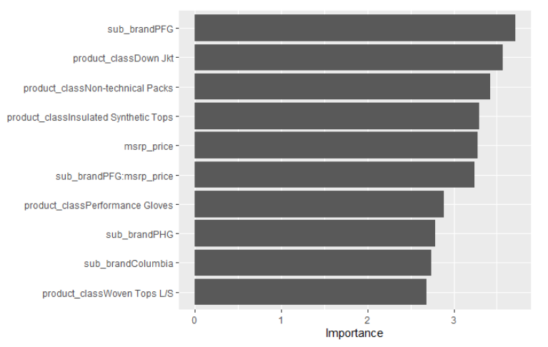
GLM #3 Variable Importance
Notes:
sub_brand = PFG, product_class = Down Jkt, Product_class = Non-Technical Packs, product_class = Insulated Synthetic Tops, msrp_price

Slide 71
Other Classification Models
Decision Tree
Support Vector Machine
Random Forest

Slide 72
Decision Tree Classification Model
A decision tree is a decision support tool that uses a tree-like model of decisions and their possible consequences.
Add Variable Importance
https://en.wikipedia.org/wiki/Decision_tree

Slide 73
Decision Tree Classification Model
rpart(less2k ~
primary_technology + product_class + sub_brand + msrp_price,
data = training_set)data = training_set)

Slide 74
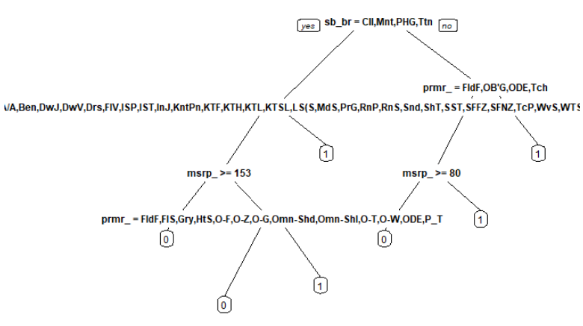
Decision Tree Visual

Slide 75
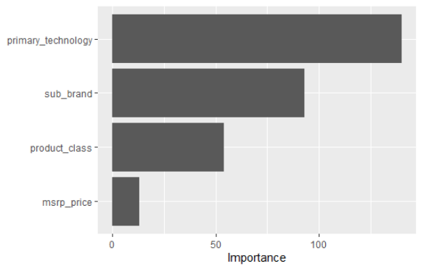

Slide 76
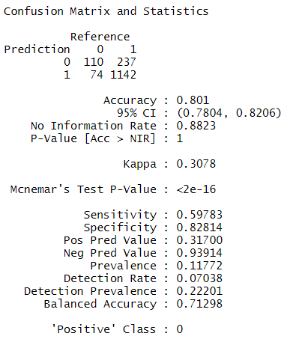
Decision Tree Results
Confusion Matrix
 | 0 | 1
0 | True Positive | False Negative
1 | False Positive | True Negative
Confusion Matrix
Accuracy of Model
Sensitivity | Correct Negative Predictions divided by the total number of Negatives
Specificity | Correct Positive Predictions divided by the total number of Positive

Slide 77
Decision Tree Results
Accuracy of Model
Confusion Matrix
Kappa
McNemar’s Test P-Value
Sensitivity | Correct Negative Predictions divided by the total number of Negatives
Specificity | Correct Positive Predictions divided by the total number of Positive
Pos Pred Value
Neg Pred Value
Prevalence
Detection Rate
Detection Prevalence
Balanced Accuracy

Slide 78
Support Vector Machine Classification Model
Supervised learning models with associated learning algorithms that analyze data used for classification and regression analysis.
Add Variable Importance
https://en.wikipedia.org/wiki/Support_vector_machine

Slide 79
Support Vector Machine Classification Model
svm(less2k ~
primary_technology + product_class + sub_brand + msrp_price,
data = training_set

Slide 80
Support Vector Machine Classification Model

Slide 81
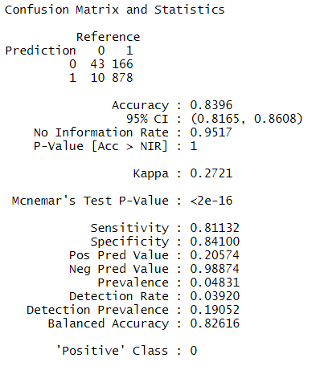
Support Vector Machine Results
Confusion Matrix
Confusion Matrix
 | 0 | 1
0 | True Positive | False Negative
1 | False Positive | True Negative
Accuracy of Model
Sensitivity | Correct Negative Predictions divided by the total number of Negatives
Specificity | Correct Positive Predictions divided by the total number of Positive

Slide 82
Random Forest Classification Model
Constructs a multitude of decision trees at training time and outputting the class that is the mode of the classification
Add Variable Importance
https://en.wikipedia.org/wiki/Random_forest

Slide 83
Random Forest Classification Model
randomForest(less2k ~
less2k ~ primary_technology + product_class + sub_brand + msrp_price,
data = training_set,)

Slide 84
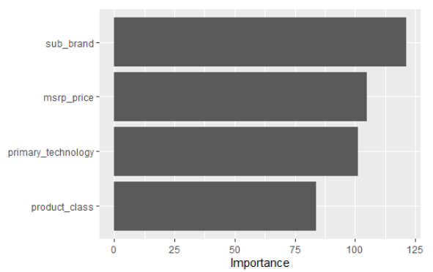
Random Forest Classification Model

Slide 85
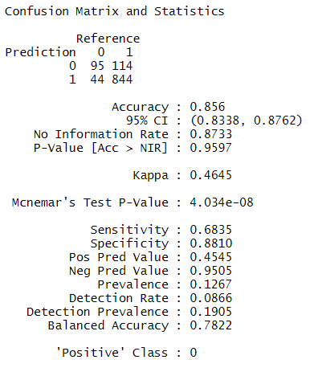
Random Forest Results
Confusion Matrix
Confusion Matrix
 | 0 | 1
0 | True Positive | False Negative
1 | False Positive | True Negative
Accuracy of Model
Sensitivity | Correct Negative Predictions divided by the total number of Negatives
Specificity | Correct Positive Predictions divided by the total number of Positive

Slide 86
XGBoost Classification Model

Slide 87
XGBoost Classification Model

Slide 88
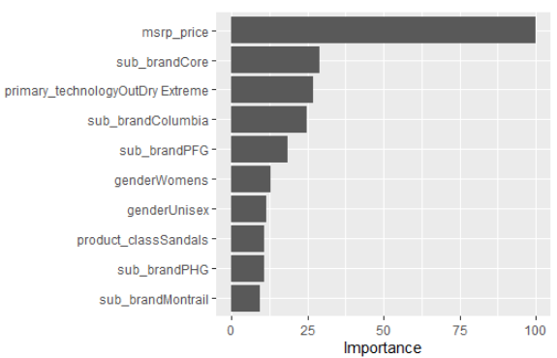
XGBoost Variable Importance

Slide 89
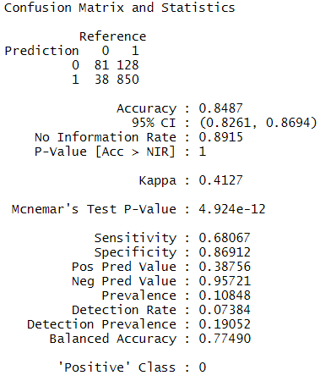
XGBoost Classification Model Results
Confusion Matrix
Confusion Matrix
 | 0 | 1
0 | True Positive | False Negative
1 | False Positive | True Negative
Accuracy of Model
Sensitivity | Correct Negative Predictions divided by the total number of Negatives
Specificity | Correct Positive Predictions divided by the total number of Positive

Slide 90
Model Comparison
Statistical Model | Accuracy | Sensitivity | Specificity | Pos Pred | Neg Pred
Generalized Logistic Model | 60% | 8% | 77% | 10% | 72%
Decision Tree | 84% | 63% | 86% | 34% | 95%
Support Vector Machine | 83% | 81% | 84% | 21% | 99%
Random Forest | 86% | 68% | 88% | 46% | 95%
XGBoost | 85% | 68% | 87% | 39% | 96%

Slide 91
Conclusion
Are there any interesting relationships between the explanatory variables?
Several categorical variables experience collinearity
Strategic Category - Product Line & Gender
Product Type – Product Line
Product Class – Product Type
Merchandise Collection – Sub Brand
Season – Spring Fall
Interaction between Sub Brand and MSRP to the response variable

Slide 92
Conclusion
How accurate is a Generalized Logistic Model (G.L.M)?
Statistical Model | Accuracy | Sensitivity | Specificity
Generalized Logistic Model | 58% | 12% | 74%

Slide 93
Conclusion
Which variables are important in the GLM?
sub_brand = PFG,
product_class = Down Jkt,
Product_class = Non-Technical Packs,
product_class = Insulated Synthetic Tops,
msrp_price

Slide 94
Conclusion
With the same explanatory variables, how does the G.L.M. compare to other classification statistical models?
Statistical Model | Accuracy | Sensitivity | Specificity | Pos Pred | Neg Pred
Generalized Logistic Model | 60% | 8% | 77% | 10% | 72%
Decision Tree | 84% | 63% | 86% | 34% | 95%
Support Vector Machine | 83% | 81% | 84% | 21% | 99%
Random Forest | 86% | 68% | 88% | 46% | 95%
XGBoost | 85% | 68% | 87% | 39% | 96%

Slide 95
Future Work
Further explore interactions between explanatory variables
Tuning other classification models
Apply Model to F20 data once season is complete

Slide 96
THANK YOU

